Slide 1


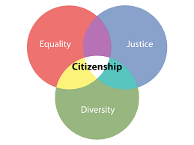












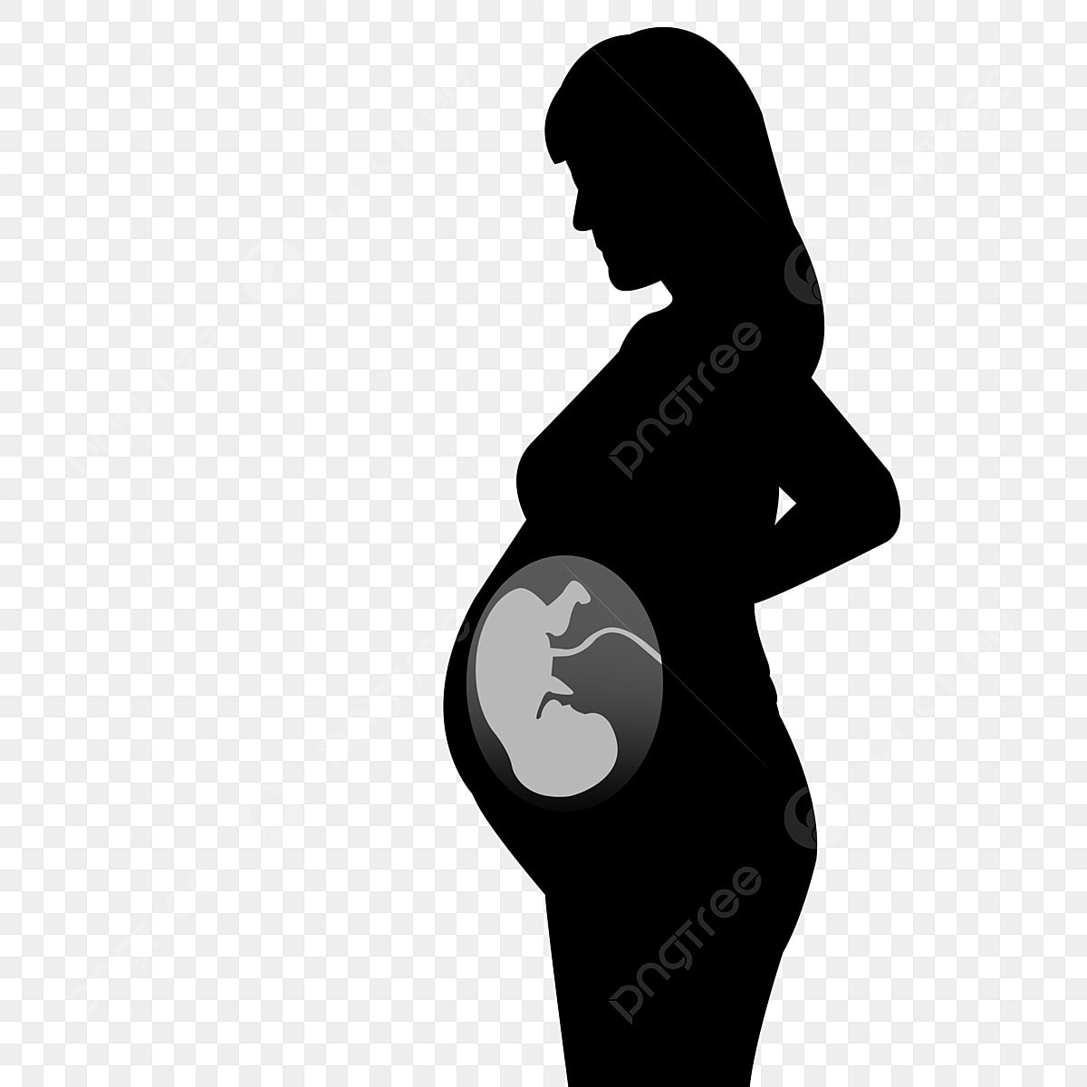
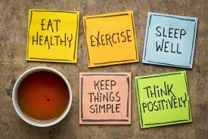
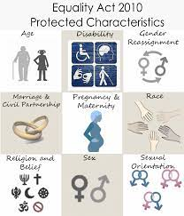


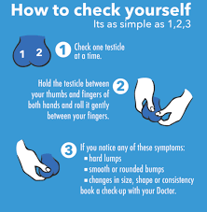



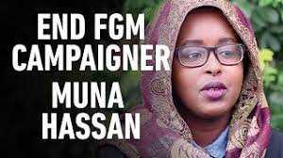







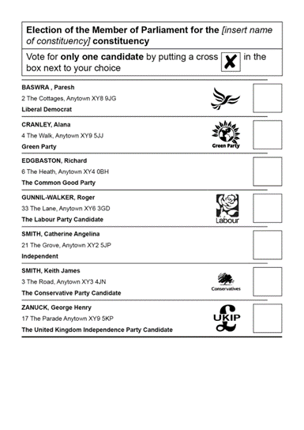



PHSCE KS4 Learning Journey
Core concepts
Year 10
1. Living in the wider world 2. Relationships 3. Health & well-being 4.Citizenship
Year 11
The importance of voting
Registering to vote
Careers – the impact of social media
Citizenship
Unrealistic expectations
Health & wellbeing & Living in the wider world
Safe sex
Pornography
Exploitation & abuse in relationships
DAT & staying safe
CEIAG
Pregnancy, fertility & the menopause
Marriage, parental responsibilities
Relationships & sex expectations
Physical & mental health
Health & wellbeing
Health & wellbeing
Year
11
Mental health
Social attitudes to sending nudes
British values: Equalities Act
Careers
Health & wellbeing and Living in the wider world
Healthy relationships
Citizenship and health & wellbeing
Drugs and alcohol education
Gangs
Citizenship & relationships
Being health aware
Social attitudes to sending nudes
Active citizenship
Is the UK democratic?
Respectful Relationships
Transition from KS3 to KS4
Health & wellbeing
Year
Valuing diversity
Citizenship
Living in the wider world
10
Reframing negative thoughts
Self image
Parliament week
What is democracy?
Credit and debit
Fraud
Citizenship & respectful relationships
Mental health & wellbeing
Finance, tax and budgeting
Excellence Truth Justice Sincerity Freedom Joy Internationality

