Slide 1




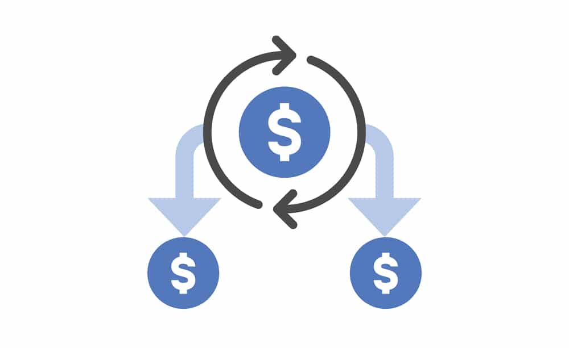















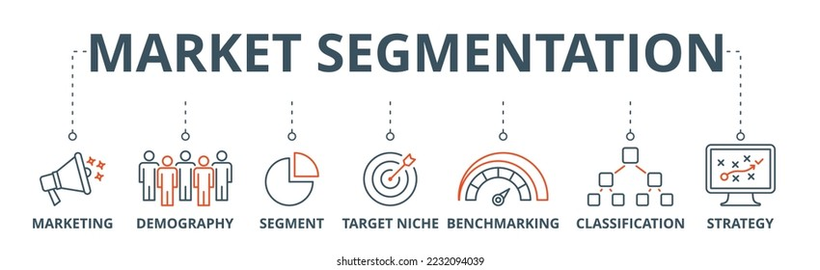














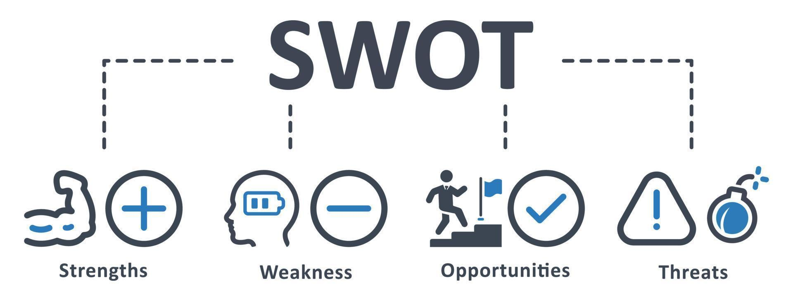
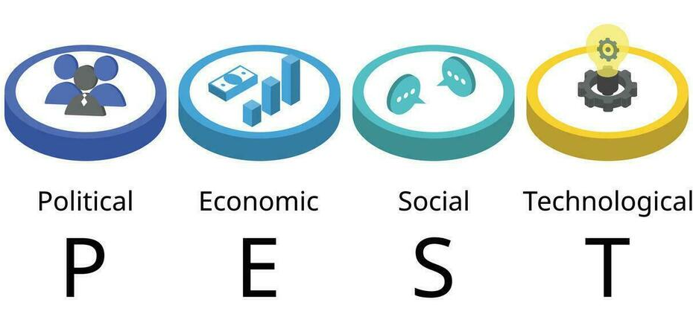


BTEC Enterprise
Curriculum Learning Journey
Exam resit in May/ June
Exam in January/ February
Revision – Bridging gaps from February exam
Component 3C –Financial Planning and Forecasting
Component 3B – Financial Documents and Statements
Component 3: Marketing and Finance for Enterprise
Component 3A – Marketing Activities
Year 11
Component 3A – Marketing Activities
Task 2b – Reviewing the presentation
Component 3: Marketing and Finance for Enterprise
Submit Component 2
Task 1b – Planning your chosen micro-enterprise idea
Task 2a – Presenting your business plan
Task 1a – Choosing an idea
Submit Component 1
Component 2: Planning and Presenting a Micro-Enterprise Idea
Task 3b – SWOT analysis
Task 3a – PEST analysis
Task 1b – The impact of the skills and characteristics of the entrepreneur
associated with a selected enterprise to its success
Task 2 – Market research methods
Task 1a – The impact of the activities carried out by the selected enterprise to
its success
Year 10
Component 1: Exploring Enterprises

